Slide 1
Project Integration Management
Phil Pfeiffer
Fall, 2014

Slide 2
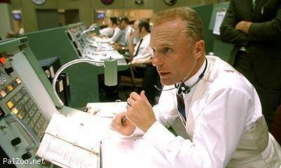
Project Integration Management
Setting project direction, then steering project
Managing & coordinating other management processes: scope, time, risk, etc.

Slide 3
What Project Integration Management Involves
Developing a project charter
Creating a management plan
Directing and managing project execution
Monitoring and control project work
Overseeing cross-task-set change control
Closing projects and phases
Keeping records of what's being done
Weakly cohesive task set -
"coordinate work" only commonality amongst these tasks

Slide 4
PMBOK Assumptions about Recordkeeping Mechanisms
Configuration management system (CMS)
▪ a shared archive of electronic documents that supports their versioned management
▪ document - schedules, documentation, source code, etc.
▪ version - identifier for a set of related artifacts that indicates
▪ when those objects were archived
▪ relative to earlier objects
▪ management - includes ability to
▪ access archived objects by name and version
▪ add new versions of objects to the archive
▪ PMBOK also assumes an integrated change log -
i.e., record of when, how, and why artifacts change

Slide 5
PMBOK Assumptions about Recordkeeping Mechanisms
Assumptions log
▪ documents assumptions about project scope
Issues log
▪ documents misc. concerns about project development
Stakeholders register
▪ documents identities, characteristics of project stakeholders
Risks register
▪ documents project risks and countermeasures

Slide 6

Creating a Project Charter
Defines project's scope, objectives, participants
Gives preliminary delineation of roles, responsibilities
Outlines objectives, identifies main stakeholders,
Defines extent of a project manager's authority.
Serves as reference of authority for project's future

Slide 7
Management Plan: Potential Elements
▪ A life cycle model for the project
▪ A description of what processes will be used to do the project and how they will be applied
▪ A scope for the work
▪ A schedule for doing the work
▪ A plan for tracking the project's cost-performance
▪ A plan for change management
▪ A plan for managing the project's configuration
▪ A plan for communicating with stakeholders
▪ A schedule for reviewing open issues
▪ Subsidiary plans for managing other, focused aspects of work (scope, time, schedule, cost, quality…)
Green items - minimal project plan

Slide 8
Direct, Manage Project Execution
Key outputs: deliverables; work performance information; change requests; updates to project plan, to requirements, logs, registers
Monitor, Control Project Work
Tracking, reviewing, regulating progress
Reviewing past: performance information
▪ collecting, measuring, distributing, assessing
▪ checking data for process inefficiencies
Assessing present
▪ using measurements to compare planned vs. actual status
Anticipating future
▪ addressing gaps in project plan
▪ anticipating future: risk management, forecasting

Slide 9
Managing Change
Outputs
▪ updates to change requests, project plan, project documentation
Closing Project or Phase
Outputs
▪ updates to organizational process assets
▪ project files, closure documents,
historical information/ postmortems

